Slide 1
Song and Meditation
With Ms. Cindy Novelo

Slide 2
Yesterday we talked about the special way we treat people when we notice their inner value or dignity.
Do you remember what happened when a young man noticed the inner value of people and nature around him?

Slide 3
1.What happens to people when we see their dignity and treat them with fairness? What happened to people and non-humans in the video?
Kinder
The girl went to school
They become better people to be around
They become happier
They start seeing other people’s dignity
They become more humble (nice to people, thankful)
Everything starts blooming
2. What happens to us when we treat other people with fairness? What did the boy receive in return?
Kindness
People start treating you better
Positive emotions (feeling love)
You receive thankfulness
happiness
Notes:
Children’s responses

Slide 4
Is it easy or hard to treat other people with fairness as the young man did?
It is not hard but you may not want to.
It can be easy but people may not choose to do it.
It depends on how we are feeling. If we are feeling happy it is easier to treat other with fairness.
It depends on how the other person is responding and treating you.
How did he help others?
Donating/giving something
Put some energy/time to help
He shared kindness, love, happiness, joy
He shared his food
He shared his money
Notes:
Children’s responses

Slide 5
When we are willing to give away something that is valuable to us in order to help others, that is
sacrifice.
Have you ever sacrificed for someone or do you know anyone who has sacrificed for others?

Slide 6
https://www.youtube.com/watch?v=OnZfRh_7tzw
What did you like about this video?
Is it hard to make a sacrifice for someone you love?
How about making a sacrifice for a stranger? Would it be harder?
Is sacrifice the same as suffering?

Slide 7
What do you think would happen if no one was willing to sacrifice?
Can you think of something that is valuable to you (your time, your talent, a toy) and who you would give it to honor their dignity?
Notes:
Main Room - Clara

Slide 8
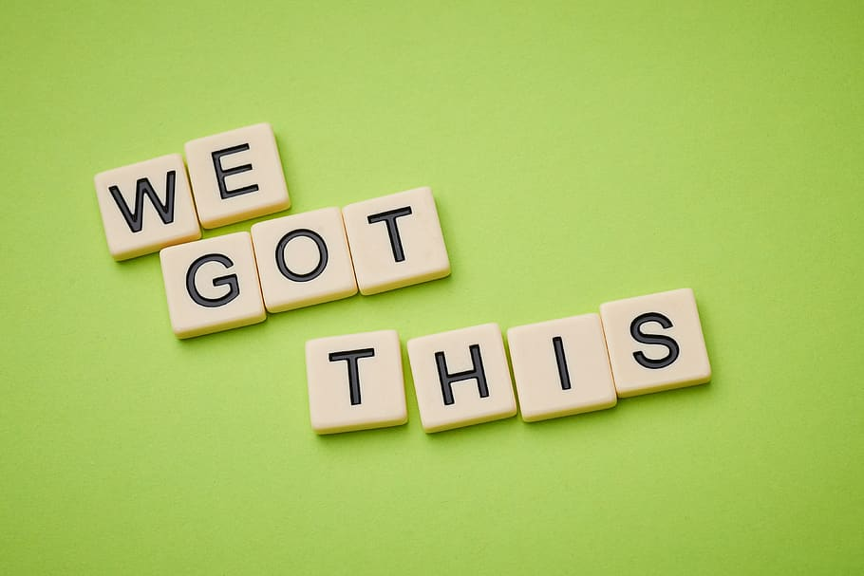
Pictionary Game
Notes:
Break out rooms
Gift/present
Help
Happy
Nature
Time

Slide 9
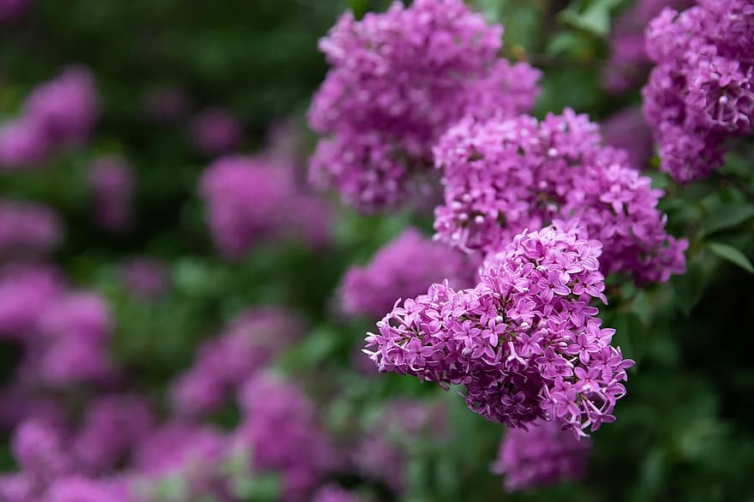
Learning Sign Language for Song “Hello World” by Red Grammer https://www.youtube.com/watch?v=Yb_50CbFu08
Notes:
Watch until min 2:52

