Slide 1
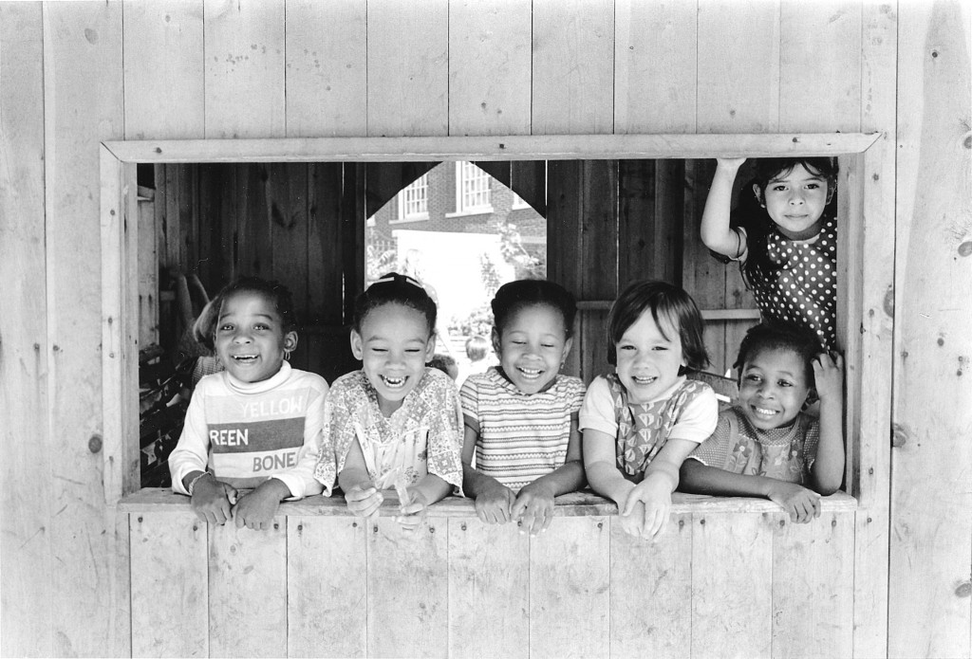
Oneness means we ARE interconnected.
It means I CAN experience other people’s feelings: their pain AND their joy!
It also means that the
way to honor my own dignity,
is by honoring
other people’s dignity.
Notes:
MAIN ROOM

Slide 2
The young man in the video was able to make all those sacrifices without receiving any “visible” reward because the pain of those strangers was his own pain and their joy was his own joy.
Notes:
MAIN ROOM

Slide 3
Let's watch the video of the young man again. Ask us to stop the video whenever you see someone experiencing oneness.
https://www.youtube.com/watch?v=uaWA2GbcnJU&t=5s
Notes:
MAiN ROOM

Slide 4
What do you think makes it difficult for us to experience
oneness?
You are not willing to try
You are happy and satisfied and you don’t think about others
You are mad and you don’t think about others
If you are always competing
If you don’t like the other person
If you want to be more powerful than others and better than others
When we don’t see or do not relate to others and keep it to ourselves
When you are depressed and transfer your anger to other people.
When you are not open to receive other people’s love
Notes:
Main Room. Children’s answers

Slide 5
For many people it is hard to experience oneness with those who look different from them. They feel and think that their skin color, or their place of birth, or their money sets them apart, so they can’t experience oneness and treat everyone with fairness.
How about you, do you have friends who look different from you? Do you love and care for all your friends the same way?
How about your parents? Do they have friends who look different from them?
Notes:
BREAKOUT ROOM

Slide 6
I Would Never Ever....
judge a person by the way they look
Make friends by choosing the way they look
Judge someone by their past
Treat someone differently because of their skin or the amount of money they have or their religion or the way they talk/ walk
Treat someone poorly because of cultural traditions
Treat someone badly because they don’t know how to draw
Treat someone badly because of a disability
Have a favorite friend or teacher because of how they look or how rich they are
Not be friends with someone because of how they look
Never be racist
Never treat someone differently because of how they look
Never even hate someone because of their skin color
Never dislike someone because of what food they eat
Never ever think more of myself than others
Never treat someone differently due to sexualty
Notes:
BREAKOUT ROOM GAME: If you are trying to experience oneness/avoid prejudice

Slide 7
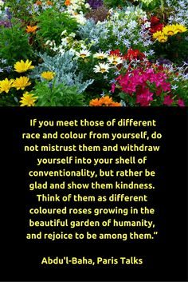
What is this quote asking us to do?
To not ignore people who are different from you, interact with them.
Imagine people as being different but also similar.
Imagine them being unique in their own way yet similar.
To respect people
Don’t think they are worse or better than you
To be happy and joyful to be with people who are different from you
Think of people as leaves of one tree
Treat people equally
Notes:
MAIN ROOM – Children’s answer

Slide 8
At home, today, talk to your parents about this quote and ask them what you can do as a family to experience human oneness.
Notes:
MAIN ROOM. Ask the children to discuss the meaning of the previous quote with their parents and ways their family could practice what the quote is asking us to.
Ask them to come ready to share their conversation and ideas with the group tomorrow.

Slide 9
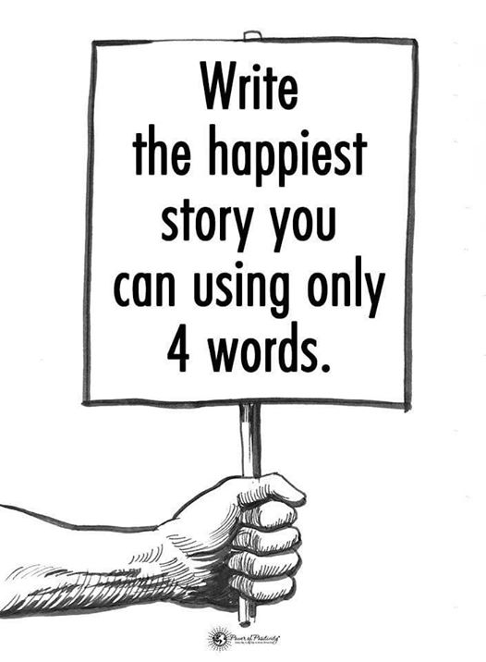
Notes:
MAIN ROOM

Slide 10
4 Word Story:
The best day ever
Be happy and kind
Don’t worry be happy
The person lived happily
Bob shared with Tom
GTR in 20 minutes
Eat strawberry cake forever
Fluffy unicorns on rainbows
Pool, cake party pizza
Notes:
Type your answers in the chat box

Slide 11
Another obstacle to Oneness is Materialism

Slide 12
What is Materialism?
Material things
Thinking too much about material stuff
-Using too many resources
Greed
Tendency to consider material possessions more important than spiritual values
Wanting to have more and more even when you don’t need it
-
-
-
Notes:
MAIN ROOM

Slide 13
Materialism is when we want to have more and more things only for our own joy and pleasure.
Why do you think materialism makes it hard for us to experience Oneness?
Notes:
Charlie - Main Room
Materialism distracts us from realizing how other people are feeling.

Slide 14
What is the opposite of Materialism? Is it not having things?
When you have a lot but use it for everyone’s well-being, is this still materialism?
What about if you don’t have much? Could you still be materialistic?
Notes:
BREAKOUT ROOMS
Maybe not because you are not distracted from the feelings of others, you are using it for the good of many.
You can still be materialistic if you do not have much because your can still be fixated on worldly possesions.

Slide 15
CHAIN STORY
One day my little sister wanted to use my sparkling markers
Notes:
BREAK OUT ROOM

Slide 16
The best way to avoid Materialism is by practicing
Detachment
Ask yourself:
Why am I doing what I am doing? Is it only for my own pleasure or do I also want to help others?
AND
2. How can I do things differently so I DO help others?
Notes:
MAIN ROOM.

Slide 17
What would you do in this situation if you wanted to respect the boy’s dignity, treat him with fairness and practice detachment, all at the same time?
https://www.youtube.com/watch?v=pFuwUiHo-WI
Notes:
Stop video when boys meet each other and ask the question.

Slide 18
What did you like about this video?
Did the boys in this video experience oneness?
Did they honor the dignity of their new neighbor?
How did they treat him with fairness?
Do you think they made a sacrifice?
Did they practice detachment?
Notes:
Breakout Rooms
Ask for responses

Slide 19
Pictionary
Notes:
BREAKOUT ROOMS
MATERIALISM
DETACHMENT
ONENESS
COLORFUL
GARDEN

