Slide 1
Honesty

Slide 2
What do you think Honesty is?
Notes:
Main Room

Slide 3
The Definition of Honesty:
Honesty is being truthful in what we say or do. Honesty also means having integrity towards others.
Notes:
Adib

Slide 4
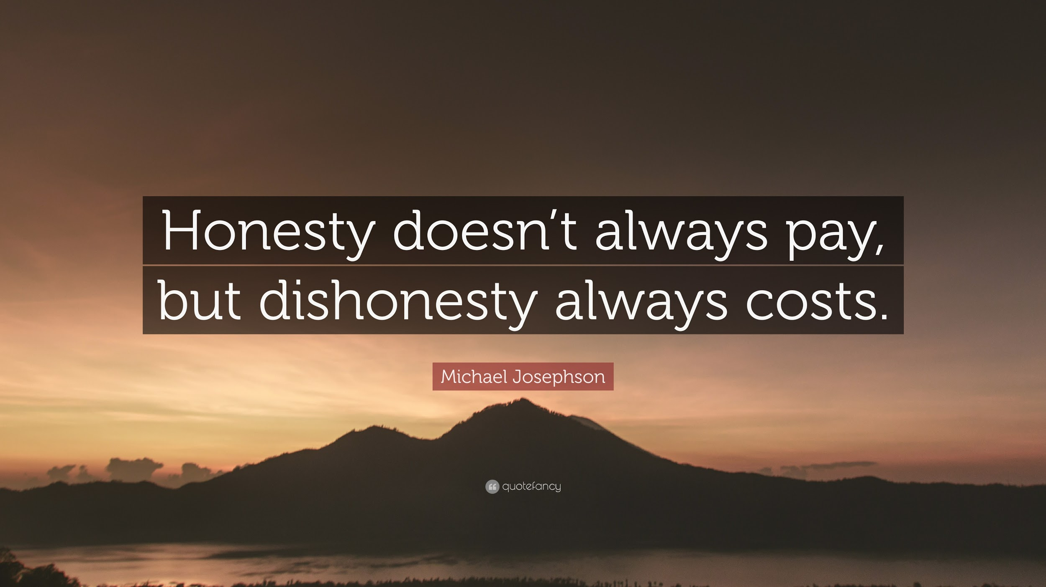
Quotes on Honesty
Notes:
Nitya

Slide 5
Why is honesty important?
Can we have social justice without honesty? Why?
What other qualities that we have talked about help us be honest with others?
Do you think it is difficult to show honesty?
Notes:
Breakout Rooms

Slide 6
Video Showing Honesty
https://www.youtube.com/watch?v=ZKL-ncMdZrs
Notes:
Main Room- Charlie

Slide 7
Questions about the Video
How did the kid show honesty?
Do you think it was hard for the kid to show integrity?
What would have happened if the kid was dishonest?
Was the other kid being dishonest?

Slide 8
Game
Two Truths and a Lie

Slide 9
What about if you are a dishonest person?
How does being dishonest affect the people around you?
How does it affect the person who is being dishonest?
What would happen if everyone around us was honest?
Notes:
Main Room- Nitya

Slide 10
How can you practice honesty at home with your family?
With your friends?
How about honesty at school?
Notes:
Main Room- Adib

Slide 11
Homework:
Talk to your parents about the meaning of honesty and ask them what the quote below means to them.
“Truthfulness is the foundation of all human virtues”

Slide 12
Thanks for joining!!!

