Slide 1
We learned that everyone has inner value or dignity, no matter how different we are.

Slide 2
Because we are all born with dignity,
would it be fair to treat some people better than others?

Slide 3
Let’s watch a video about how we treat others when we see and honor their dignity
https://www.youtube.com/watch?v=uaWA2GbcnJU

Slide 4
1.What did you like about this video?
2.How do we treat people, animals and
nature when we see their dignity or inner value? How did the young man treat them?
3. Is fairness giving everyone the same thing?
Notes:
Remind the children that the man didn’t share his lunch with the plant but with the dog. He didn’t share his money with the dog but with the child. Fairness is treating people in a way that they can become the best version of themselves - in a way that their inner value or dignity can be revealed or made manifest.

Slide 5
1.How do we know when we are treating people with fairness?
2. What happens to people when we see their dignity and treat them with fairness? What happened to people and non-humans in this video?
3. What happens to us when we treat other people with fairness? What do we receive in return?
Notes:
Fairness is not treating people only according to where they are in life at the moment but according to their potential, to what they can become. Even when someone behaves badly we can still recognize their inner value and treat them with fairness. When we honor people’s potential, we don’t treat them anyway we want - we don’t even punish them anyway we want, as if they were an old chair or an old rug.

Slide 6
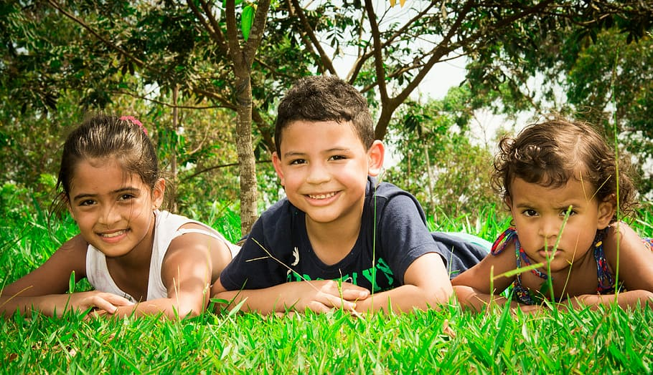
See Me Beautiful in sign language
Until second 55 https://www.youtube.com/watch?v=hySJwCKk2nA&list=RDhySJwCKk2nA&start_radio=1

