Slide 1
Meditation and song with
Ms. Cindy Novelo

Slide 2
Introductions:
Where are you joining us from and
What makes you happy?

Slide 3
Dignity
What do you think it means?
Notes:
MAIN ROOM: 11:20-11:23 - We all are different from one other and we also have many things in common. There are things, for example, that we have in common only with our family or friends but not with other people and there might be something we have in common with strangers but not with our friends. There is one quality about us, however, that we share with EVERYONE. That is our dignity. Have you ever heard of the word dignity?

Slide 4
Human Dignity
Did you know that you were born with dignity? And so were all your friends and also everybody else?
How does it feel to know you were born with dignity?
How do you think we treat each other when we notice our dignity or inner value?
How do we treat people when we don’t notice their dignity?
Dignity is our inner value. Everyone is born with dignity and we all keep it throughout our lives - no matter how we look, how we talk, how much or little we have, or even how we act or how others treat us.

Slide 5
https://www.youtube.com/watch?v=MQcN5DtMT-0
Why do you think Anano was treated well sometimes and poorly other times?
Have you ever felt that people didn’t notice your inner value? Why do you think this happened?
Is seeing other people’s dignity our own choice or does it depend on how other people behave or how they treat us?
Notes:
Let’s watch a video to see how we treat people when we don't notice their dignity.

Slide 6
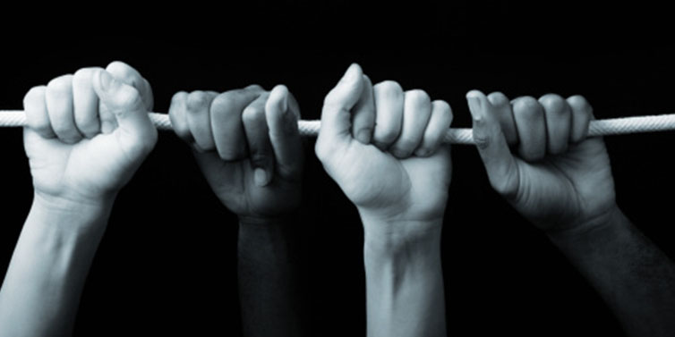
- What do you think are some barriers that make it difficult for us to see dignity in everyone?
- What do you think would help us see dignity in everyone?

Slide 7
Game: hangman
Hangman
Notes:
Dignity (7 words)
Respect (7 words)
Equality (8 words)
Choice (6 words)

