Slide 1
Find out from your friend:
What is their favorite food
One of their favorite stories or books
What makes them happy or sad
What they like to study and learn about
Notes:
BREAKOUT ROOMS

Slide 2
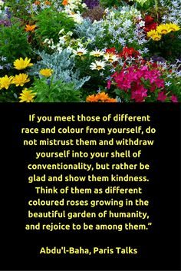
How can you practice what
this quote is asking us to do:
. Stand up for those who are being bullied at school, if I see this happening.
-pay attention and say hello to people you meet
- be kind to people
- to value people
-to hang out with new people and make them feel appreciated
- give gifts to the poor
- make friends with anyone new to school
- if anyone is being left out, invite them to play together
Notes:
MAIN ROOM – Children’s responses

Slide 3
This week we talked about all that we gain when we treat others fairly and with dignity, make sacrifices for one another and experience our oneness. The more we practice these qualities, the better we get at them!!
Humility helps us practice
ALL these qualities.
What do you think humility means?
Notes:
MAIN ROOM - Charlie

Slide 4
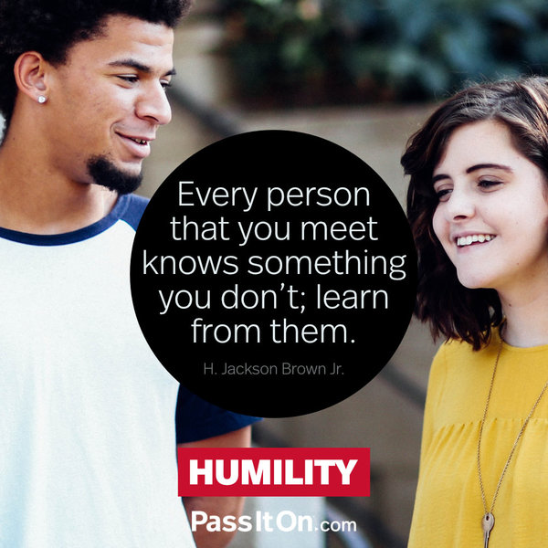
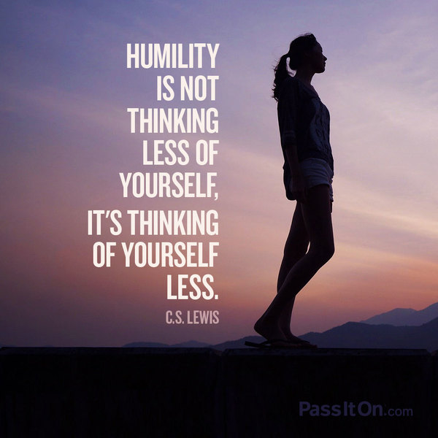
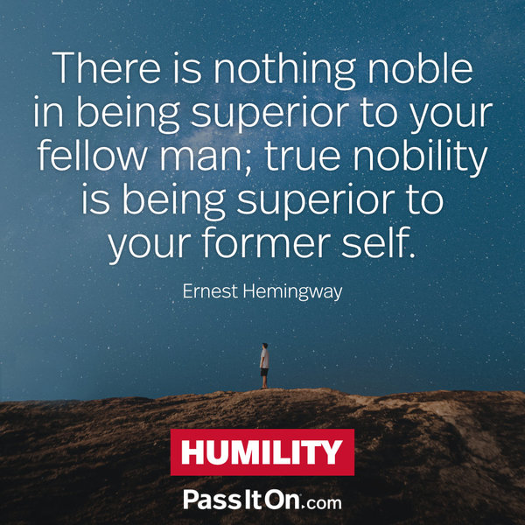
Notes:
MAIN ROOM - ADIB, Nitya and Charlie

Slide 5
We watched a few videos this week. Can you think of examples of people practicing humility in them?
Did you see any examples of a lack of humility?
Notes:
Breakout Room

Slide 6
Do you see people practicing humility around you? At school? At home? On TV?
In your opinion, what do people think when they see someone showing humility?
How do you feel when someone shows you humility?
Have you shown humility to other people? If so, how do you think they felt when you showed them humility?
Notes:
Breakout Room

Slide 7
CHAIN STORY
John only is friends with kids who have good grades...
Maria likes to talk about herself and her day to everyone she meets...
A friend likes calling people's attention and correcting them every chance he has...
Notes:
BREAKOUT ROOM - Clara - create a story to show what would humility look like in these situations.

Slide 8
CHAIN STORY
John only is friends with kids who have good grades like him… but he is starting to change. John started to change one day when he found one of his friends at his house showing kindness to their brother. When John saw his friend showing an act of kindness, he thought about how he could make a difference by doing the same. Arriving home that day, John made the decision to hug his brother, Jackie. This is was a surprise to his brother, Jackie, because previously, he would steal his toys. At school, he began making friends with everyone. Soon all the other kids were playing with him. From then on, he was nice to everyone. He didn’t realise how wrong it was to not make friends with certain people until he got a bad grade, and he didn’t even realize that his old friends were now bullying him.
Notes:
BREAKOUT ROOM - Children’s response

Slide 9
CHAIN STORY
John only hangs out with kids who have good grades but only a few of the kids in his class have good grades so he didn’t have a lot of friends. One day John came back to school and he thought about how many friends he had. John decided to tutor the other kids for free to help them get good grades. ...
Notes:
BREAKOUT ROOM - Children’s response

Slide 10
Why do you think we need humility to:
See dignity in everyone?
To treat people with fairness?
To experience oneness?
To practice detachment?
Notes:
Main Room

Slide 11
How can you practice humility at home?
And with your friends?
What about practicing it with strangers?
Notes:
BREAKOUT ROOM

Slide 12
Treasure Hunt
Find in your house any of the following items and bring them to the screen:
Something your parents made/created that required sacrifice
Something you made/created that required sacrifice
Something you love to share with your friends
Something you would like to give away to make someone else happy

Slide 13
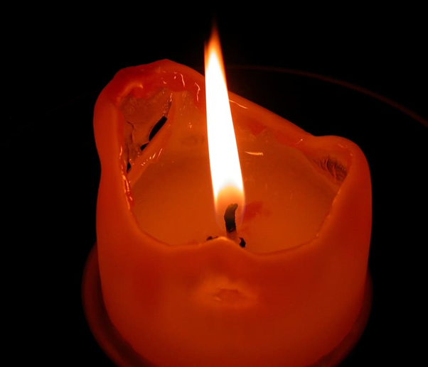
“Behold the candle, how it gives its light. It weeps its life away drop by drop, to give its flame.”
Abdu’l-Bahá
Notes:
Memorize and discuss the meaning of this quote with your family.

Slide 14
Do a painting or drawing representing any one of these qualities:
Dignity, Fairness, Sacrifice, Oneness, Detachment OR Humility
Notes:
Ask the children to take a picture of their artwork and email it to adibrabbani@gmail.com so you can post it on the Facebook page Just Art
Along with your picture, let us know the size of your work, title and material used.

