Slide 1
Have you ever been in a situation where you had to be courageous?
What does it take to be courageous?
Notes:
Main Room

Slide 2
“Each time a man stands up for an ideal, or acts to improve the lot of others, or strikes out against injustice, he sends forth a tiny ripple of hope.” –Robert Kennedy
Notes:
Main Room - What do you think is the meaning of this quote? (Kerav)

Slide 3
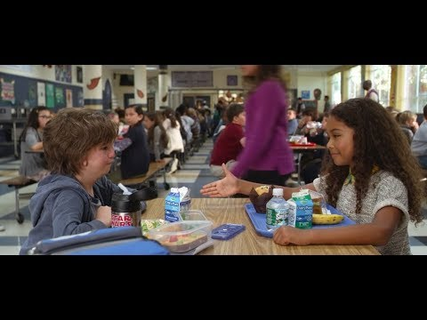
Notes:
Main Room https://www.youtube.com/watch?v=iUj2vEIiPLc

Slide 4
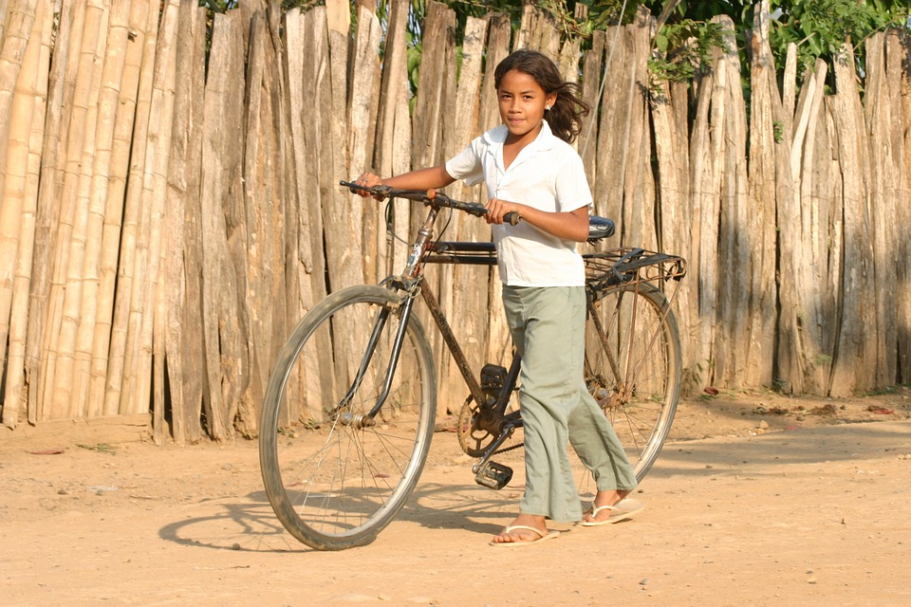
Does it take courage for Summer to talk to Auggie? Why?
What do you think courage means?
Can you think of something you have gained or lost by showing courage?
Can you name an act of courage you have noticed in someone around you (friend, family, teacher)?
Notes:
Breakout Rooms - Courage is doing the right thing, regardless of what other people do or think or how you may personally benefit from it in the short term. (If in Main, NITYA)

Slide 5
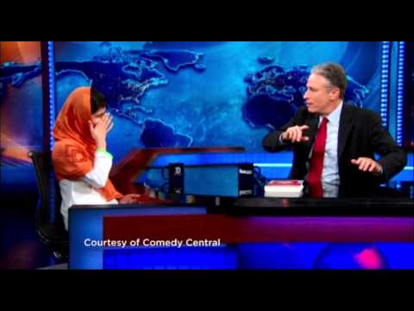
Can you think of how one person’s act of courage has benefited a lot of people?
Notes:
Main room https://www.youtube.com/watch?v=8yIqMk4POmA (CHARLIE)

Slide 6
How has society benefited from Malala’s courage?
In this video, Malala displays civil courage. Can you think of someone else who has shown civil courage?
Why do you think civil courage is important?
“Each time a man stands up for an ideal, or acts to improve the lot of others, or strikes out against injustice, he sends forth a tiny ripple of hope.” –Robert Kennedy
Notes:
Main room: Courage requires avoiding shortcuts and choosing the right means to our goals. (ERIN)
With courage we can work to change injustices around us. Without courage everything remains always the same, there is no change, no improvement.
When one person shows courage it instills hope in others and make them also braver.
Courage helps us build a more inclusive society (where everyone’s dignity is equally honored).

Slide 7
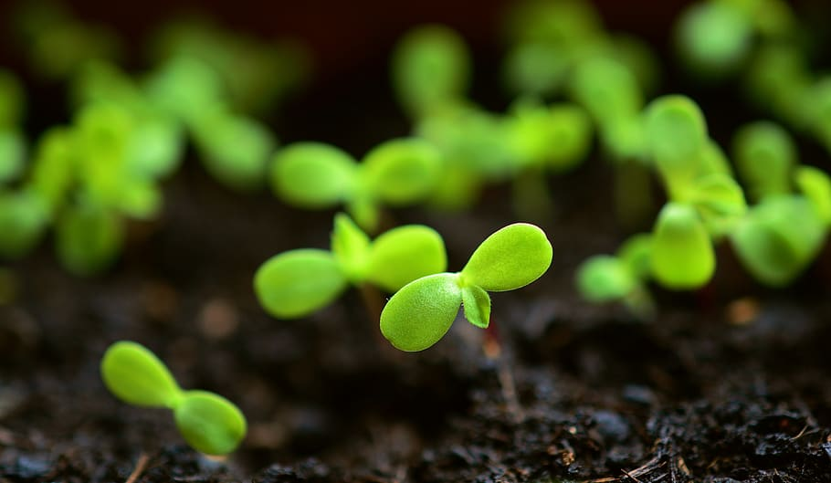
What does it take to show civil courage?
Why can’t we have justice without civil courage?
How can you and your family show civil courage?
Notes:
Breakout room (If in Main, KERAV)

Slide 8
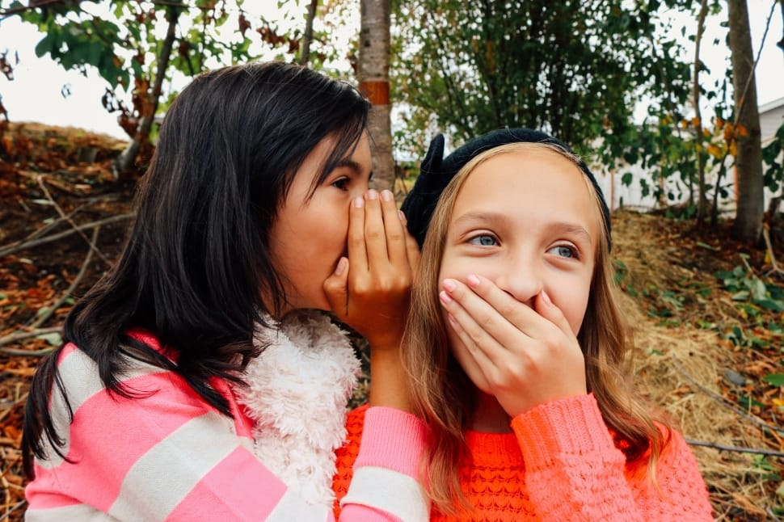
Whispering Game!
Notes:
Mainroom - (we still have to choose words/short sentences) (KERAV)
EQUALITY
INCLUSION
RIPPLE OF CHANGE

